Slide 1
Banking Analytics
Presented by group -2
18/02/2026

Slide 2
Meet Our team:
GROUP - 2
Anish Kumar
Johns M
Priyanshu Patra
Anshu Patel
Sriram Sambamoorthy
Shivali Chavan
Donthi Rama Dasthagiri

Slide 3
Debit And Credit Banking Data
Report
Objective:
To analyze performance and risk indicators using KPIs.
In summary, our dashboards are designed for bank transaction monitoring and analysis — helping financial analysts or managers track money flow, compare credit vs. debit performance across banks and branches, spot trends over time, and flag potentially risky transactions.

Slide 4
Tools
Excel
Power Bi
Project Management Tools
Tableau
MYSQL
Dataset: Debit Credit Data

Slide 5
Introduction
About the Project
This project focuses on analyzing credit and debit transaction data across multiple banks and branches to generate meaningful financial insights
The objective is to transform raw banking transaction records into clear, actionable information for financial decision-making
Centralized Power BI, Tableau, Excel dashboards have been developed to monitor transaction performance, flow trends, and risk levels.
Purpose
Gain a comprehensive understanding of overall credit and debit flow and transaction growth trends across banks and branches
Identify high-risk transactions, credit-to-debit imbalances, and branches with unusual activity

Slide 6
Data Overview
Total Rows Used: 1Lakh
Total Columns Used: 13
Important Columns:
Customer ID, Account Number,
Month, Transaction Type, Amount, Balance
Branch, Transaction Method, Bank Name

Slide 7
Objectives - KPIs
1. Total Credit Amount : Measures the total amount of deposits or credits
2. Total Debit Amount : Measures the total amount of withdrawals or debits.
3. Credit to Debit Ratio : Total Credit Amount ÷ Total Debit Amount
Insight: Shows the ratio of credits to debits, which helps to understand whether the bank is receiving more deposits than withdrawals
4. Net Transactions : Total Credit Amount - Total Debit Amount.
Insight : Measures the net cash flow (positive or negative) for the bank over a period.

Slide 8
Objectives - KPIs
5. Activity Ratio : Number of transactions ÷ Account balance.
Insight: Indicates how active a customer is in relation to their balance.
6. Branch Transaction Growth : Percentage change in the total transaction amount or volume at each branch over a defined period.
Insight: Identifies whether a particular branch is growing or declining in terms of transaction volume.
7. Transaction Amount by Branch
8. Distribution by transaction Method
9. High Risk Transaction Flag : Flag transactions that exceed a predefined amount or show irregular activity (e.g., large withdrawals or deposits).
Insight: Helps to identify potentially fraudulent transactions that need further investigation

Slide 9
Process
Step 1: Data Cleaning
Checked for null values and duplicates in transaction records
Corrected date formats for Transaction Date column
Standardized Bank Name, Branch, and Transaction Method fields for consistency
Step 2: Created Calculated Fields & Measures
Total Credit Amount — sum of all inflow transactions
Total Debit Amount — sum of all outflow transactions
Net Transaction Amount — difference between credit and debit
Credit-to-Debit Ratio — to measure financial balance
Account Activity Ratio — to track account usage
High Risk Count & Normal Count — to classify transaction risk levels

Slide 10
Process
Step 3: Built Charts
Line Charts — Monthly and Quarterly transaction trends for Credit & Debit
Column Charts — Transaction amount by Branch and Bank Name
Donut/Pie Charts — Distribution by Transaction Method and Flow Direction
Gauge Charts — Credit and Debit performance against targets
Pivot Table — Branch-wise and Bank-wise breakdown of transactions
Step 4: Dashboard Design and KPI Cards
Designed 4 report pages — Overview, Credit, Debit, and Details
Added KPI Cards for Total Credit, Total Debit, Net Amount, Activity Ratio, and Risk Count
Integrated Bank Name slicer for interactive filtering across all pages

Slide 11
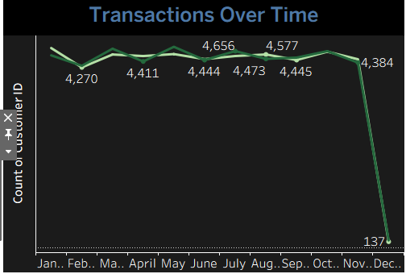
TRANSACTIONS OVER TIME
Insights:
Transactions remain stable from January to November, indicating consistent customer activity.
Highest volumes occur mid-year (around July–August), showing a seasonal peak.
December shows an extreme drop, likely due to incomplete or missing data rather than true performance decline.

Slide 12
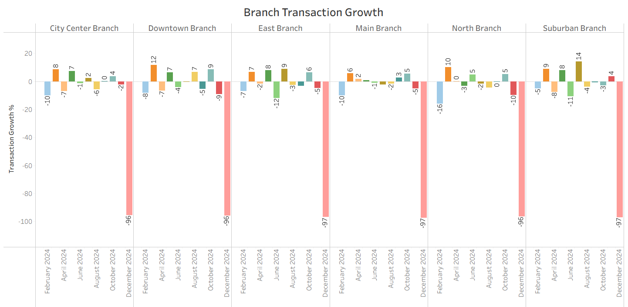
BRANCH TRANSACTION GROWTH
December 2024 saw a sharp drop of -96% to -97% across all branches — possible data gap or major disruption
Most branches stayed between -12% to +14% mid-year, with Suburban Branch peaking at +14% in August 2024
North Branch (-16%) and East Branch (-12%) were the most inconsistent performers of the year

Slide 13
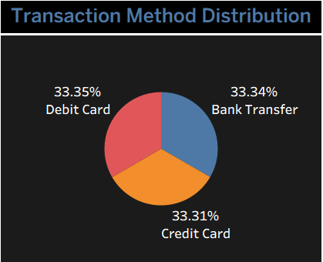
TRANSACTION METHOD
Insights:
Transaction methods are evenly distributed across Debit Card (33.35%), Bank Transfer (33.34%), and Credit Card (33.31%).
No single payment method dominates, indicating balanced customer preferences.
The organization should support and optimize all three channels equally to maintain smooth transaction experiences.

Slide 14
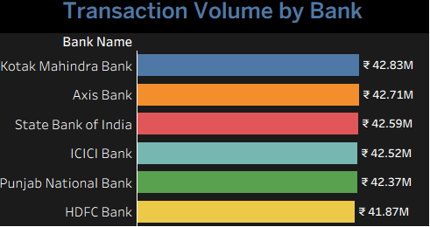
TRANSACTION VOLUME BY BANK
Insights:
Kotak Mahindra Bank records the highest transaction volume at ₹42.83M
Transaction volumes across all listed banks are very closely clustered, indicating a competitive and balanced banking landscape.
HDFC Bank shows the lowest volume among the group, but the difference is marginal.

Slide 15
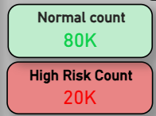
RISK FACTOR
Insights:
Normal Count: 80K
80,000 transactions are classified as normal and within safe parameters
This represents 80% of total transactions — majority of banking activity is healthy and stable
High Risk Count: 20K
20,000 transactions are flagged as high risk or suspicious
This represents 20% of total transactions — which is significantly high compared to the industry standard of below 5%

Slide 16
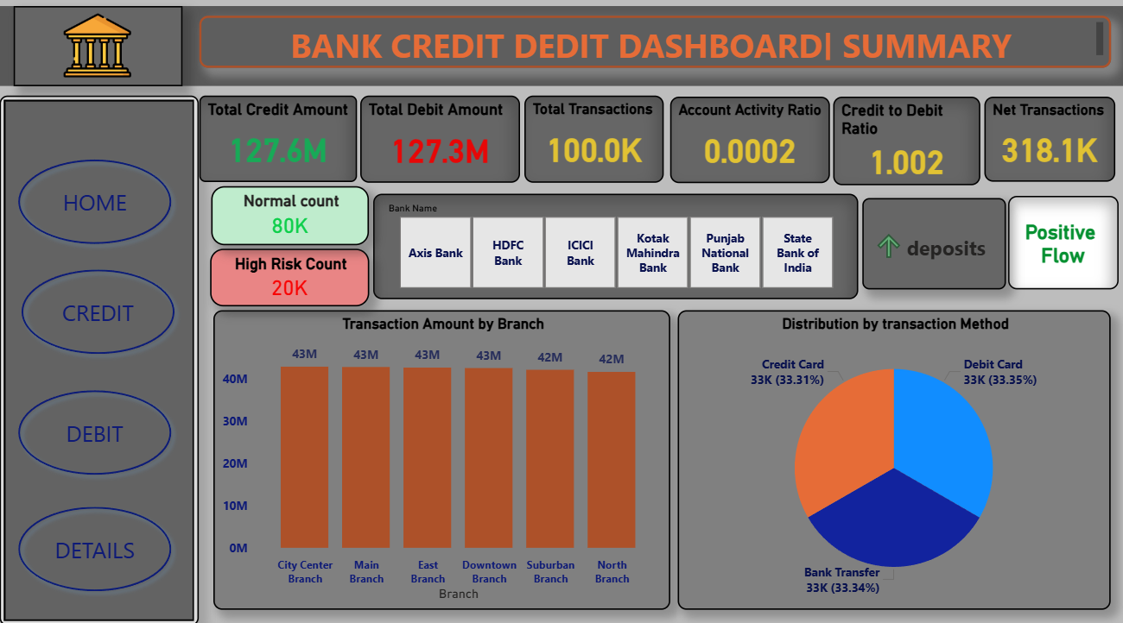
Dashboard ( power BI) :

Slide 17
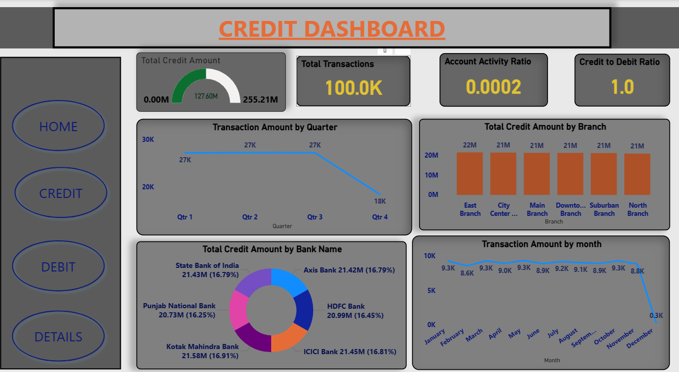
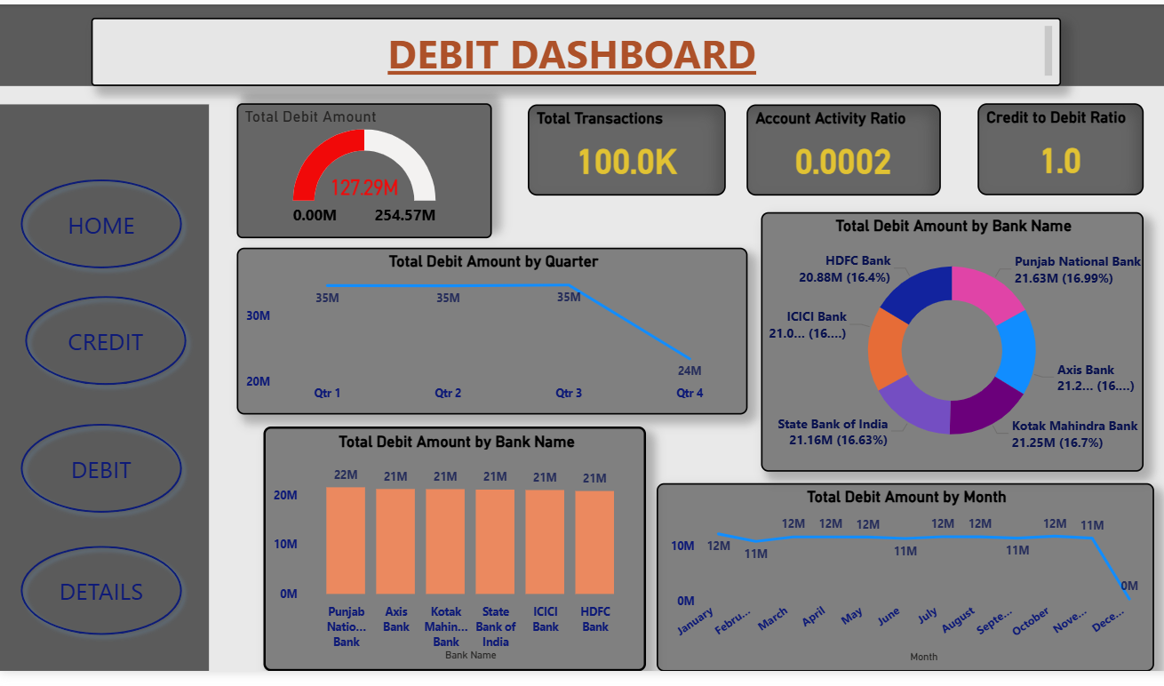
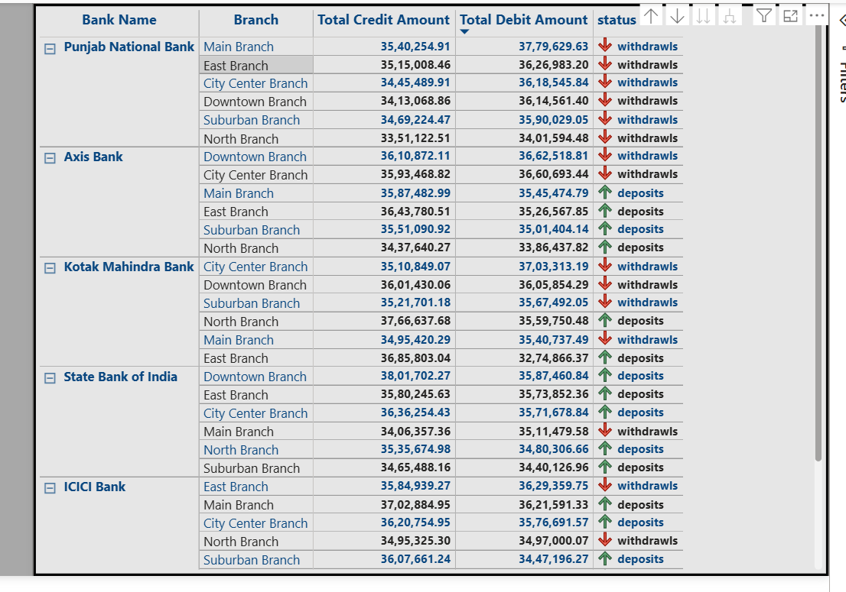

Slide 18
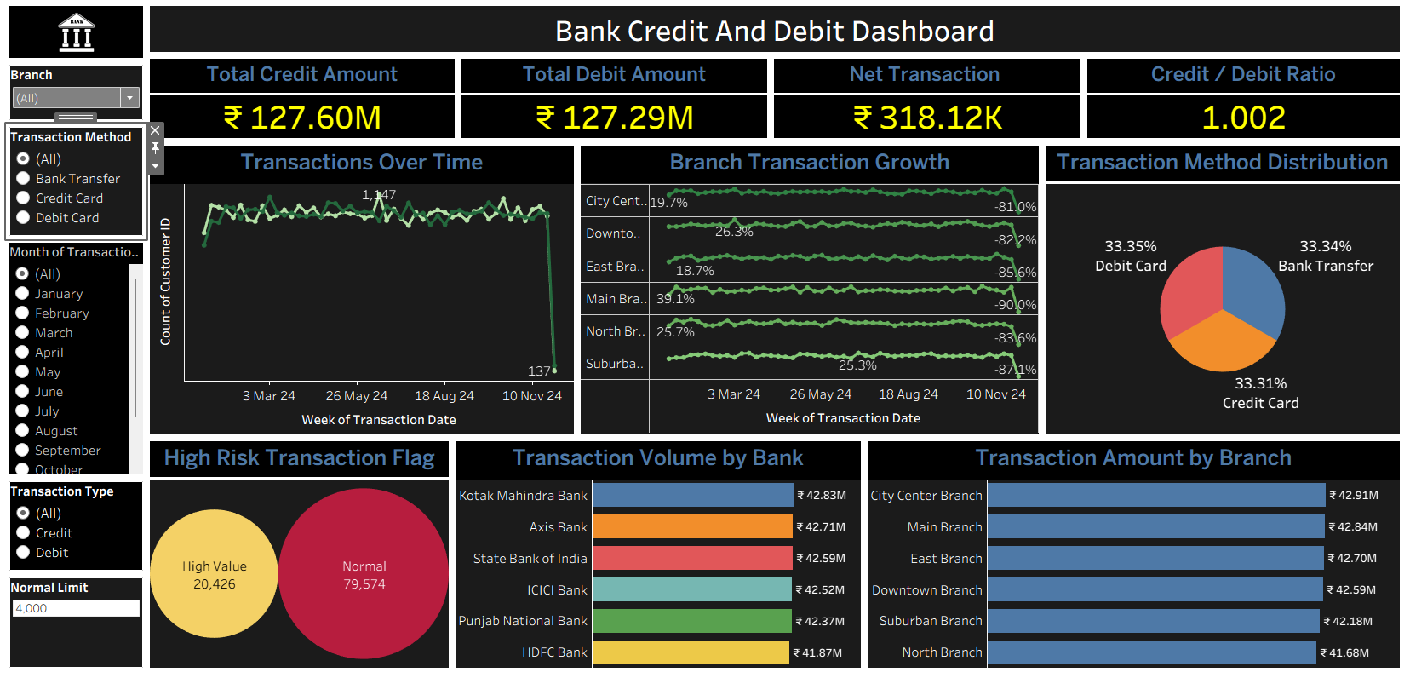
Dashboard ( Tableau) :

Slide 19
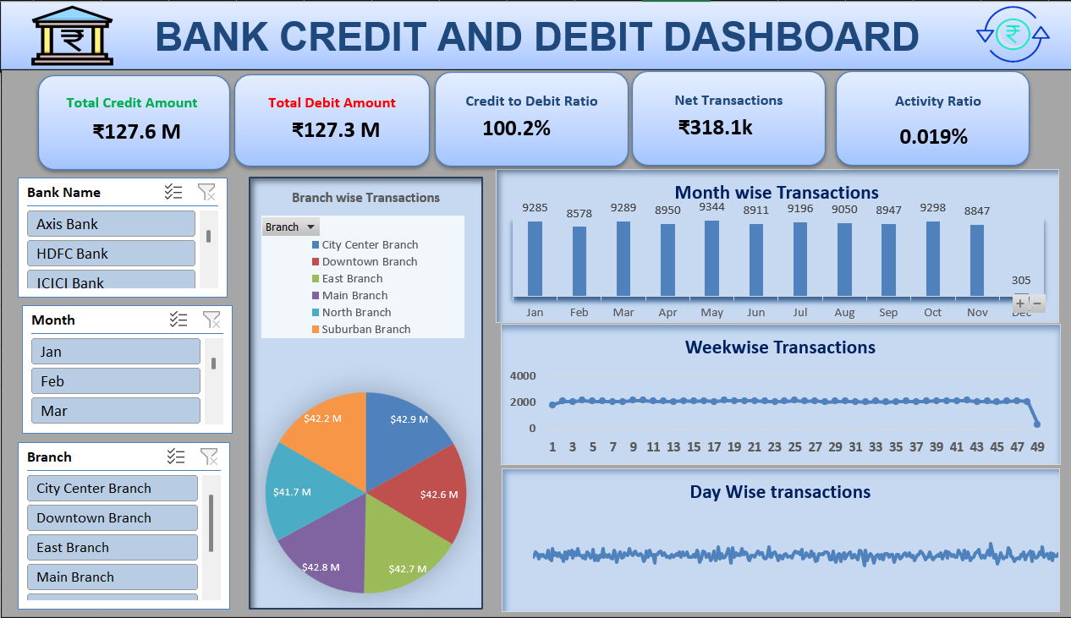
Dashboard ( Excel) :

Slide 20
Key Dashboard Insights
Total Credit : ₹127.60M
Total Debit: ₹127.29M
Credit/Debit Ratio: 1.002 - slightly above 1, meaning credits marginally exceed debits, reflecting a healthy financial balance
Top Branch by Transaction Amount: City Center Branch
Top bank by transaction Amount: Kotak Mahindra Bank
Most Steady Growth: Suburban Branch - Shows the most consistent positive growth with +9%, +8%, +14% in April, June, and August 2024
Transaction Method: Equal distribution (~33% each). No single method dominates - all three channels are equally active

Slide 21
Bank Loan Analysis RePORT
Tool Used: Tableau
Dataset: Bank Loan Analytics
Objective:
To analyze loan performance, revenue, and risk indicators using KPIs.

Slide 22
Introduction
About the Project
This project focuses on analyzing business/operational data to generate meaningful insights.
The objective is to transform raw data into clear, actionable information for decision-making.
A centralized dashboard/report has been developed to monitor performance and trends.
Purpose
Understand overall performance and growth patterns
Identify strengths, risks, and improvement opportunities
Support management with data-driven decisions

Slide 23
Scope
Data collection and validation
Data visualization and analysis
Performance monitoring across key metrics
Tools & Technology
Data Processing & Validation
Visualization Dashboard (Tableau/ Reporting Tool)
Structured database sources

Slide 24
Data Overview
Total Rows Used: 66,000 (approx.)
Total Columns Used: 15+
Important Columns:
Loan ID, Funded Amount, Total Interest, Collection, State,
Branch, Religion, Grade, Age, Product Group,
Loan Status, Default Flag, Delinquent Flag, Verification Status

Slide 25
Objectives - KPIs
1. Total Funded Amount
2. Total Loans
3. Total Collection
4. Total Interest
5. Default Loan Rate
6. Delinquent Loan Rate
7. Default Loan Count
8. Delinquent Client Count
9. Non Verified Loan %

Slide 26
Process
Step 1: Data Cleaning (Null check, format correction)
Step 2: Created Calculated Fields
Step 3: Built Charts (State, Grade, Religion, Age, Product)
Step 4: Dashboard Design and KPI Cards

Slide 27
KPI Calculation Logic
Total Funded Amount = SUM(Funded Amount)
Total Collection = SUM(Collection)
Total Interest = SUM(Total Interest)
Total Loans = COUNT(Loan ID)
Default Rate = Default Count / Total Loans * 100
Delinquent Rate = Delinquent Count / Total Loans * 100
Non Verified % = Not Verified Count / Total Loans * 100
Profit Insight = Total Collection - Funded Amount

Slide 28
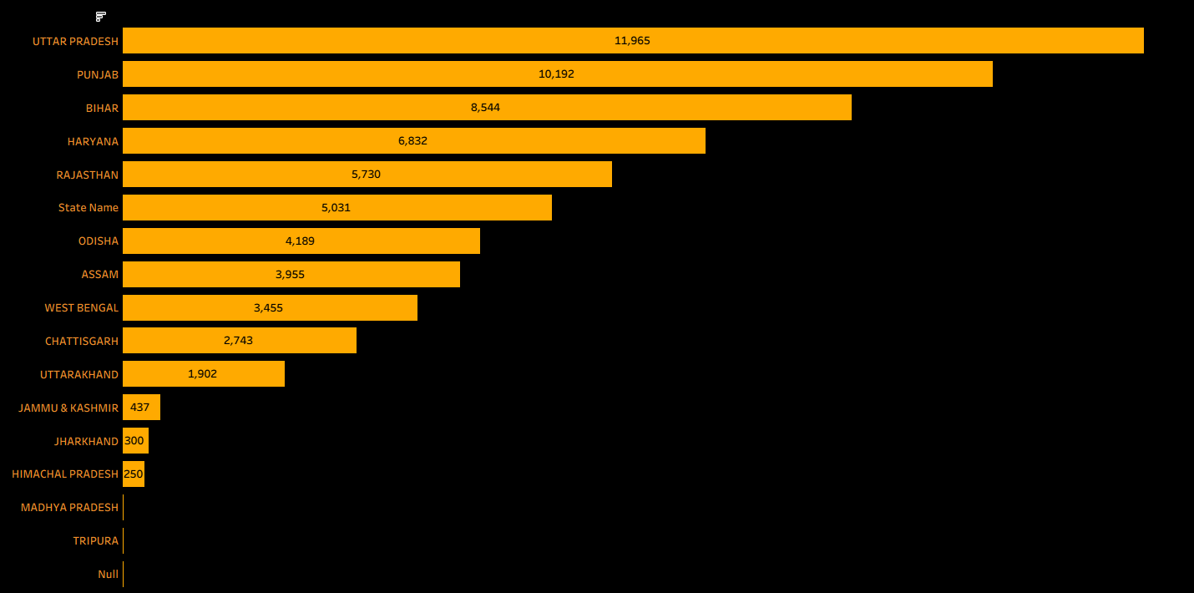
State Wise Loans
Insights:
Uttar Pradesh and Punjab dominates
Bihar, Haryana and Rajasthan and Mid range clusters
Odisha ,Assam, West Bengal contribute moderately
Jammu & Kashmir, Uttarakhand and Himachal Pradesh are at bottom
Overall distribution skewed to specific states, showing imbalance

Slide 29
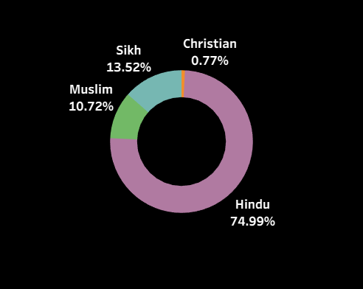
Religion Wise Loans
Insights:
Loan uptake is dominated by Hindus, with Sikhs and Muslims as significant contributors,
while Christians remain marginal.
This distribution may reflect both population proportions and access to financial services.

Slide 30
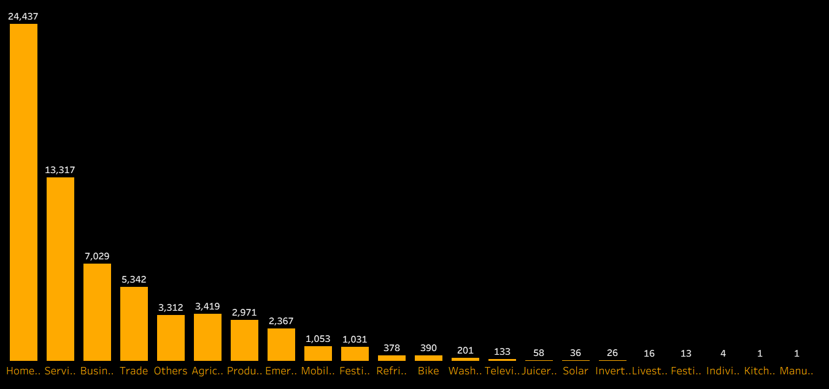
Product -Group Wise Loans
Insights:
Loan demand is concentrated in housing, services, and business,
while consumer goods and niche categories remain marginal.
This reflects a mix of basic needs, livelihood support, and selective consumer spending.

Slide 31
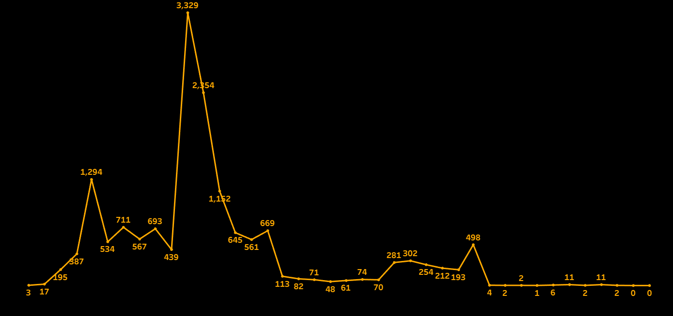
Disbursement Trend
Insights:
The disbursement trend shows three phases: rapid growth leading to a one‑time peak, followed by a steady decline and eventual near‑zero activity. This indicates the process was event‑driven rather than sustainable, highlighting the need for strategies that maintain consistency beyond peak periods.

Slide 32
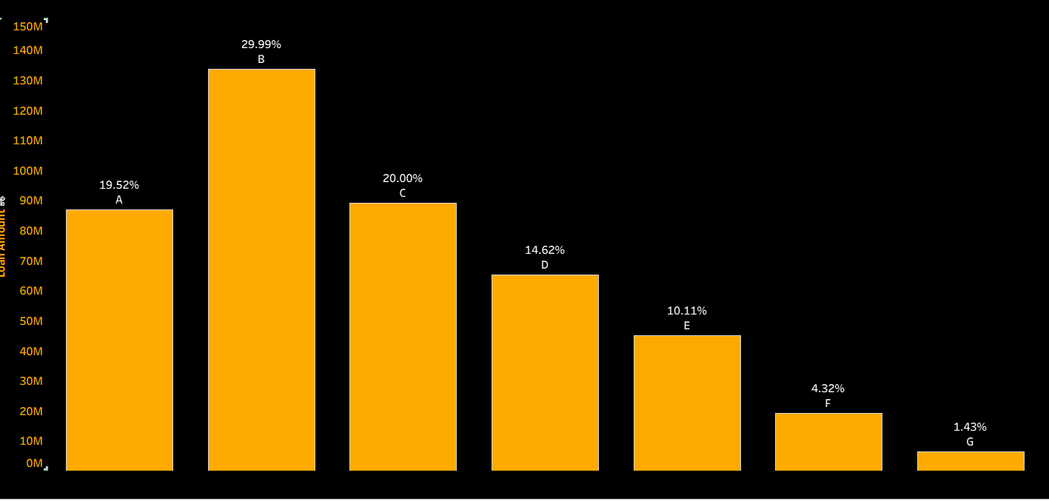
KPI -10
Grade wise Loans
Insights:
Category B dominates with nearly 30% of total loans, while A and C together contribute another 40%. The rest are much smaller, with G at just 1.4%, showing a highly skewed distribution where lending is concentrated in a few categories.

Slide 33
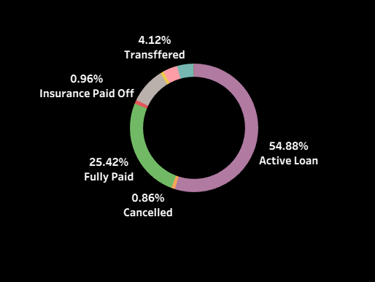
KPI -15
Loan Status wise Loans
Insights:
Over half of loans remain active (55%), while about a quarter are fully paid. The rest—transferred, insured, or cancelled—make up less than 6%, showing a portfolio that is largely ongoing with relatively low closure or risk events.

Slide 34
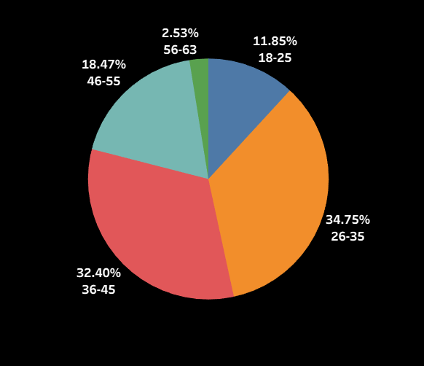
Age Group wise Loans
Insights:
The dataset is dominated by younger working‑age groups, with 26–35 (35%) and 36–45 (32%) together making up over two‑thirds of the population. Older groups above 55 are minimal, showing a strong concentration in the prime earning and borrowing age range.

Slide 35
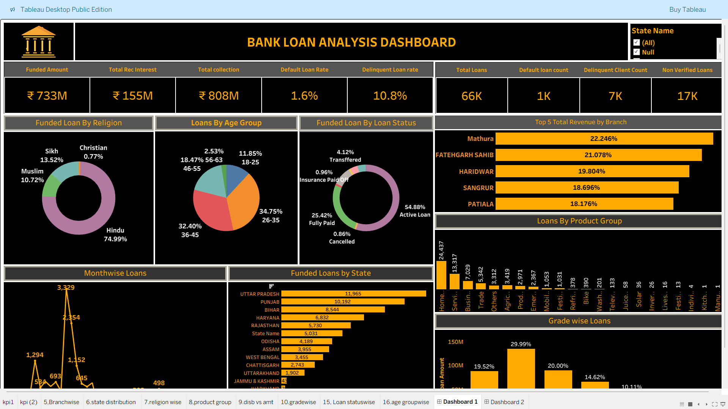
Dashboard (Tableau):

Slide 36
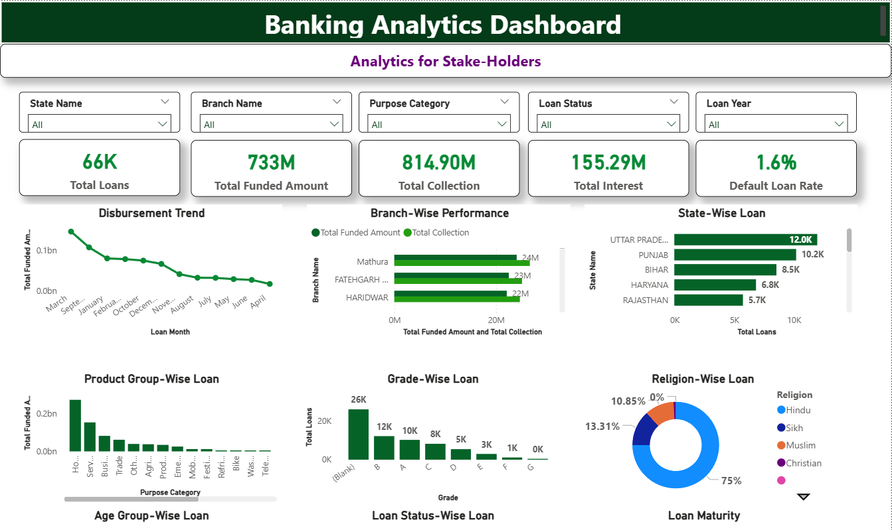
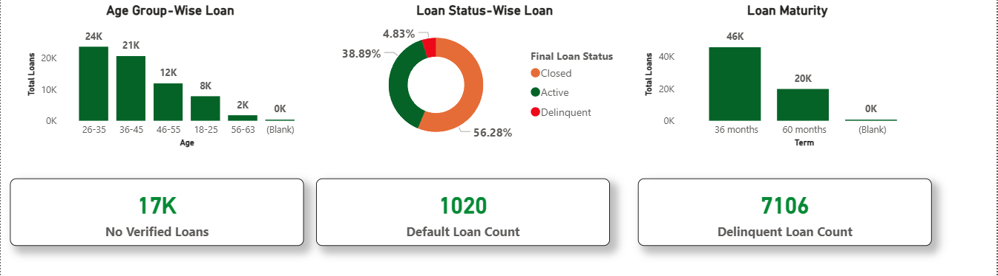
Dashboard (POWER BI):

Slide 37
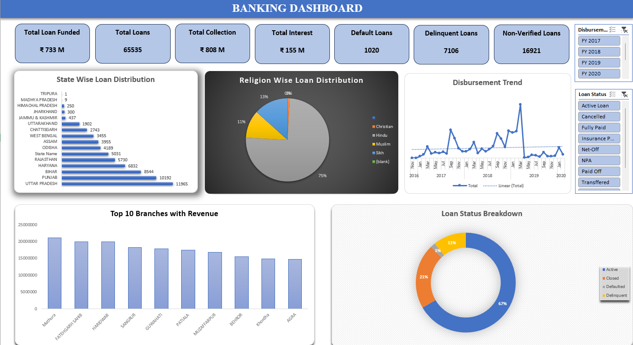
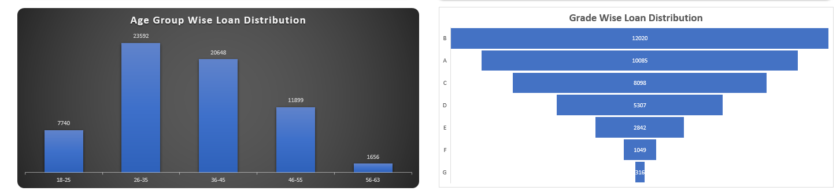
Dashboard (EXCEL):

Slide 38
Key Dashboard Insights
Total Funded: ₹733M
Total Collection: ₹808M
Default Rate: 1.6%
Delinquent Rate: 10.8%
Highest Loan State: Uttar Pradesh
Top Revenue Branch: Mathura

Slide 39
Recommendations & Insights
Reduce Delinquent Loans
Monitor Non-Verified Loans
Focus on High Performing Branches
Strengthen Credit Checks for Low Grades
Target 26-35 Age Group for Growth

Slide 40
Challenges & Learnings
Challenges:
Data Cleaning, Calculation Errors, Date Formatting
Learnings:
KPI Logic, Tableau Calculated Fields,
Dashboard Design & Data Visualization

Slide 41
Conclusion
Bank is financially strong (Collection > Funded)
Default rate is low
Delinquent rate needs improvement
Dashboard supports data-driven decision making

Slide 42


